Slide 1



08.A Listing Processes
get information about programs running on a
system to determine status, resource use, and ownership, so you can control them

Slide 2

executable program.
Security properties
execution threads
Process state
address space
What’s Process

Slide 3
environment of a process
environment
Local Var
global variables
scheduling context
Allocated system resources

Slide 4
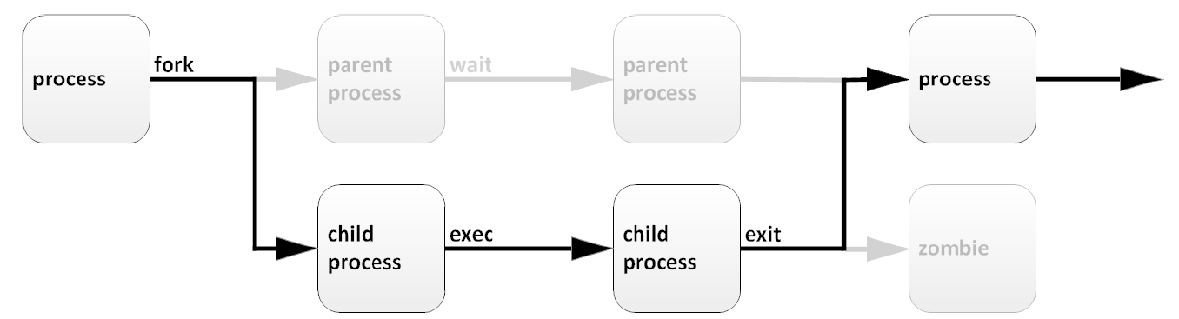
Process lifecycle
sleep
Unique PID
And PPID

Slide 5
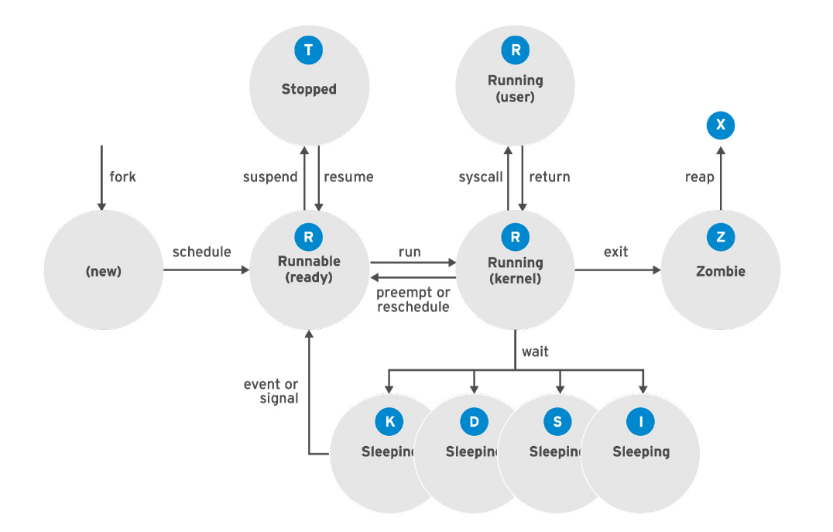
DESCRIBING PROCESS STATES

Slide 6
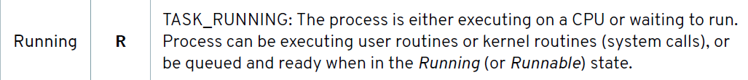
PROCESS STATES

Slide 7
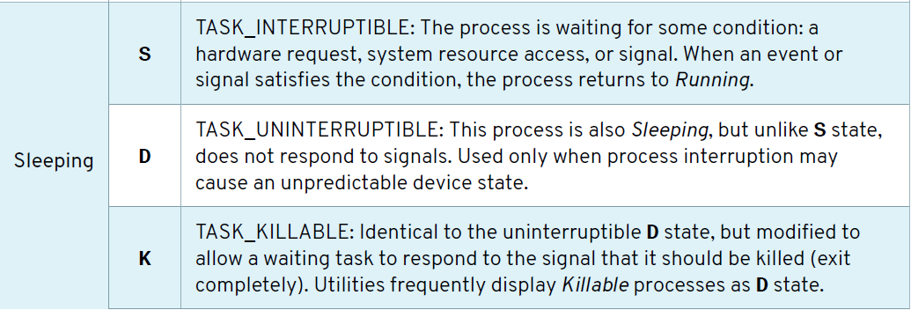

PROCESS STATES cont…

Slide 8
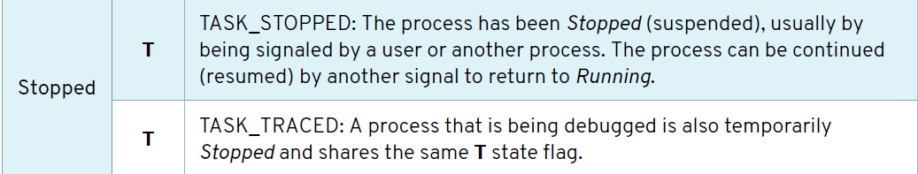
PROCESS STATES cont…

Slide 9
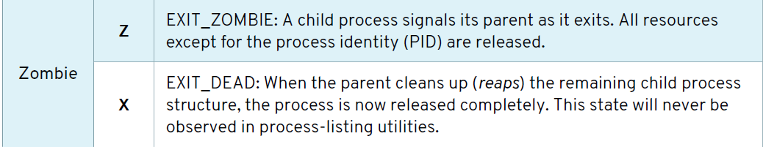
PROCESS STATES cont…

Slide 10


TOP
[user@host ~]$ top
PID USER PR NI VIRT RES SHR S %CPU %MEM TIME+ COMMAND
1 root 20 0 244344 13684 9024 S 0.0 0.7 0:02.46 systemd
2 root 20 0 0 0 0 S 0.0 0.0 0:00.00 kthreadd
...output omitted...

Slide 11
ps
[user@host ~]$ ps aux
USER PID %CPU %MEM VSZ RSS TTY STAT START TIME COMMAND
...output omitted...
root 2 0.0 0.0 0 0 ? S 11:57 0:00 [kthreadd]
student 3448 0.0 0.2 266904 3836 pts/0 R+ 18:07 0:00 ps aux
...output omitted...

Slide 12

ps
User identification (UID), which determines process privileges
Unique process identification (PID)
CPU and real time already expended
How much memory the process has allocated in various locations
The location of process stdout, known as the controlling terminal
The current process state

Slide 13
ps
[user@host ~]$ ps aux
[user@host ~]$ ps lax
[user@host ~]$ ps -ef
[user@host ~]$ ps

Slide 14
top enables you to see your processes ordered by the amount of processor power they use.
ps enables you to see all your processes, or just the processes used by certain users, for example root or yourself.

